Slide 1




ITD MONTHLY
PRESENTATION
Presented by: Akpe Nathan Omokafe
Reviewed by: Mr. Daniel

Slide 2

CONTENTS
01
02
03
ACTIVITIES
CHALLENGES AND SOLUTIONS
LEARNING POINTS
04
05
RESEARCH TOPIC
REFERENCES

Slide 3









ACTIVITIVES
01
CRIMPING OF ETHERNET CABLE
02
NETWORK CONFIGURATION
03
INSTALLATION OF MICROSOFT OFFICE
04
TRUST MANAGEMENT

Slide 4





CHALLENGES AND SOLUTIONS
COMPUTER SYSTEM RUNNING SLOWLY: DELETING OF TEMPORARY FILES AND RESTARTING THE SYSTEM.
KEYBOARD NOT REGISTERING INPUTS: DISCONNECTING AND RECONNECTING THE KEYBOARD USB CABLE IN ANOTHER USB PORT.
UNABLE TO CONNECT TO WIFI: FORGET THE NETWORK AND ENTER THE PASSWORD TO CONNECT AGAIN.

Slide 5





LEARNING POINTS
Resourcefulness
Asking of questions
Teamwork

Slide 6

APPLICATIONS OF COMPUTER TECHNOLOGY IN HEALTHCARE
Electronic Health Records
Telemedicine
Medical Imaging

Slide 7

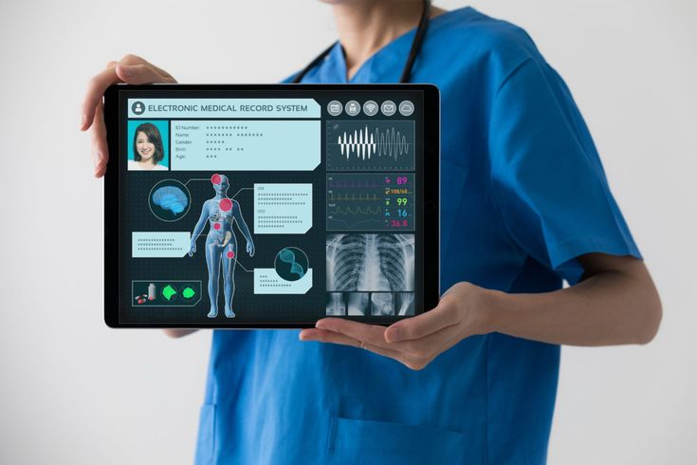
ELECTRONIC HEALTH RECORDS
Electronic Health Records (EHRs) are digital versions of patients' paper charts. They contain comprehensive health information, including medical history, diagnoses, medications, treatment plans, immunization dates, allergies, radiology images, and laboratory test results.

Slide 8


TELEMEDICINE
Telemedicine is the use of telecommunications technology to provide healthcare services remotely. It allows patients to consult with healthcare professionals via video calls, phone calls, or messaging apps, without needing to visit a clinic.

Slide 9

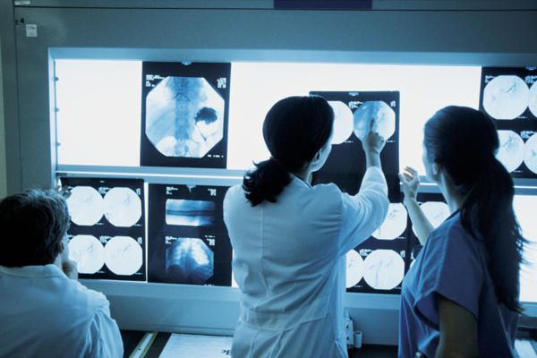
MEDICAL IMAGERY
Medical imaging refers to techniques and processes used to create visual representations of the interior of a body for clinical analysis and medical intervention. It includes a variety of imaging modalities such as X-rays,.MRIs e.t.c.

Slide 10

REFERENCES
"What is TeleHealth?". Office for the Advancement of Telehealth. The Health Resources and Services Administration. March 2022. Retrieved 12 January 2024
"What is Health Tech and how will it evolve?". Hot Topics. 30 June 2016. Retrieved 5 July 2016
Roobottom CA, Mitchell G, Morgan-Hughes G (November 2010). "Radiation-reduction strategies in cardiac computed tomographic angiography". Clinical Radiology. 65 (11): 859–67. doi:10.1016/j.crad.2010.04.021. PMID 20933639.
"Medical Radiation Exposure Of The U.S. Population Greatly Increased Since The Early 1980s National Council on Radiation Protection & Measurements. March 5, 2009. Retrieved May 9, 2019.

Slide 11



Thank's For Listening
Connect with me.
+234 811 287 5008
nathanakpe3@gmail.com

